Slide 1
UNIT III

Slide 2
Strings:
String Concepts
Strings are actually one-dimensional array of characters terminated by a null character '\0'. Thus a null-terminated string contains the characters that comprise the string followed by a null.
The following declaration and initialization create a string consisting of the word "Hello". To hold the null character at the end of the array, the size of the character array containing the string is one more than the number of characters in the word "Hello.“
Syntax:
char greeting[6] = {'H', 'e', 'l', 'l', 'o', '\0'};
(Or)
char greeting[] = "Hello";

Slide 3
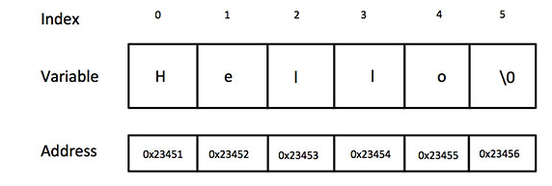
Following is the memory presentation of the above defined string in C/C++ −
Actually, you do not place the null character at the end of a string constant. The C compiler automatically places the '\0' at the end of the string when it initializes the array. Let us try to print the above mentioned string (see the example in next slide)

Slide 4
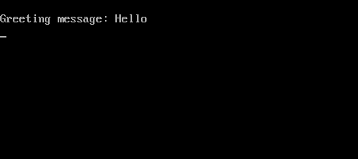
Example
#include <stdio.h>
void main ()
{
char greeting[6] = {'H', 'e', 'l', 'l', 'o', '\0'};
clrscr();
printf("Greeting message: %s\n", greeting );
getch();
}
Output

Slide 5
String I/O functions In C Language
The following are the input and output functions of strings in c
Input functions: scanf(), gets()
Output functions: printf(), puts()
There is a little difference between scanf() and gets(), while reading string from keyboard, the scanf() accepts character by character from keyboard until either a new line (‘\n’) or blank space is found, which ever comes earlier.
Whereas “gets()” accepts until a newline is found. That is it accepts white spaces & tab also, these input functions append a null character at end of string, the formatted string %s is used in printf() and scanf().

Slide 6
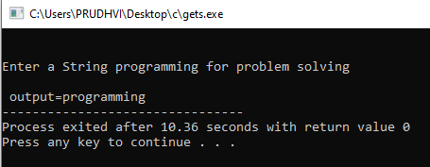
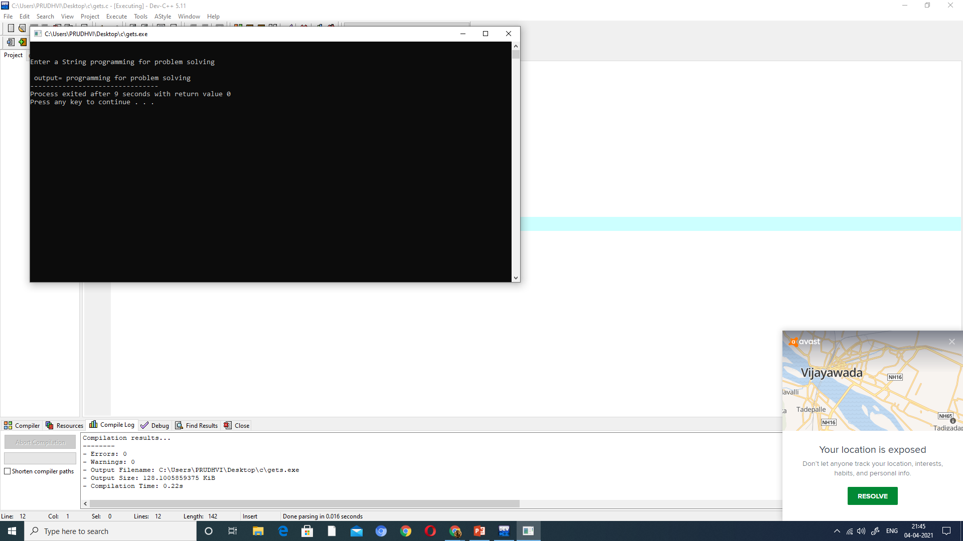
Example program showing the difference between scanf and gets
String program using scanf
String program using gets
#include<stdio.h>
void main()
{
char a[20];
clrscr();
printf("\n\nEnter a String");
scanf("%s",a);
printf("\n output=%s",a);
getch();
}
#include<stdio.h>
void main()
{
char a[20];
clrscr();
printf("\n\nEnter a String");
gets(a);
printf("\n output=%s",a);
getch();
}
Output using scanf
Output using gets

Slide 7
String Manipulation Functions
Function Work
strcat( ) concatenates two strings
strlen( ) finds the length of string
strcpy( ) copies one string in to another string
strcmp( ) compares two strings
strlwr( ) converts string to lowercase
strupr( ) converts string to uppercase

Slide 8
strcat( ) Function :
strcat( ) function in C language concatenates two given strings. It concatenates source string at the end of destination string. Syntax for strcat( ) function is given below:
Syntax : char * strcat ( char * destination, const char * source );
Example :
strcat ( str2, str1 ); - str1 is concatenated at the end of str2.
strcat ( str1, str2 ); - str2 is concatenated at the end of str1.
As you know, each string in C is ended up with null character (‘\0′).
In strcat( ) operation, null character of destination string is overwritten by source string’s first character and null character is added at the end of new destination string which is created after strcat( ) operation

Slide 9
Program : The following program is an example of strcat() function
#include <stdio.h>
#include <string.h>
int main( )
{
char source[ ] =“ftl” ;
char target[ ]= “welcome to” ;
printf ( “\n Source string = %s”, source ) ;
printf ( “\n Target string = %s”, target ) ;
strncat ( target, source, 3 ) ;
printf ( "”\n Target string after strncat( ) = %s”, target ) ;
}

Slide 10
C Program to concatenate two strings without using strcat()
#include <stdio.h>
int main()
{
// Get the two Strings to be concatenated
char str1[100] = "Geeks", str2[100] = "World";
// Declare a new Strings to store the concatenated String
char str3[100];
int i = 0, j = 0;
printf("\nFirst string: %s", str1);
printf("\nSecond string: %s", str2);
// Insert the first string in the new string
while (str1[i] != '\0') {
str3[j] = str1[i];
i++;
j++;
}
// Insert the second string in the new string
i = 0;
while (str2[i] != '\0') {
str3[j] = str2[i];
i++;
j++;
}
str3[j] = '\0';
// Print the concatenated string
printf("\nConcatenated string: %s", str3);
return 0;
}
Output:
First string: Geeks
Second string: World
Concatenated string: GeeksWorld

Slide 11
strlen( ) Function :
Calculate Length of String without Using strlen() Function
#include <stdio.h>
void main()
{
char string[50];
int i, length = 0;
printf("Enter a string \n");
gets(string);
/* keep going through each character of the string till its end */
for (i = 0; string[i] != '\0'; i++)
{
length++;
}
printf("The length of a string is the number of characters in it \n");
printf("So, the length of %s = %d\n", string, length);
}
Output: Enter a string
Sanfoundry T
he length of a string is the number of characters in it
So, the length of Sanfoundry = 10
strlen( ) Function :
strlen( ) function is used to find the length of a character string.
Example:
int n;
char st[20] = “Bangalore”;
n = strlen(st);
• This will return the length of the string 9 which is assigned to an integer variable n.
• Note that the null character “\0‟ available at the end of a string is not counted.

Slide 12
strcpy( )copies one string in to another another string
strcpy( ) Function :
The strcpy() function copies the string to the another character array.
Syntax: char* strcpy(char* destination, const char* source);
Example:
strcpy ( str1, str2) – It copies contents of str2 into str1.
strcpy ( str2, str1) – It copies contents of str1 into str2.
If destination string length is less than source string, entire source string value won’t be copied into destination string.
For example, consider destination string length is 20 and source string length is 30. Then, only 20 characters from source string will be copied into destination string and remaining 10 characters won’t be copied and will be truncated.

Slide 13
Program : The following program is an example of strcpy() function #include <stdio.h> #include <string.h> int main() { char str1[10]= "awesome"; char str2[10]; char str3[10]; strcpy(str2, str1); strcpy(str3, "well"); puts(str2); puts(str3); return 0; } Output: awesome well

Slide 14
Write a C program to copy one string to other without using strcpy() function
// Execute loop till null found
for (i = 0; s1[i] != '\0'; ++i)
{
// copying the characters by character to str2 from str1
s2[i] = s1[i];
}
s2[i] = '\0';
// printing the destination string
printf("String s2 : %s", s2);
return 0;
}
Output:
string s1 : GeeksforGeeks
String s2 : GeeksforGeeks
#include <stdio.h>
int main()
{
// s1 is the source( input) string and s2 is the destination string
char s1[] = "GeeksforGeeks", s2[100], i;
// Print the string s1
printf("string s1 : %s\n", s1);

Slide 15
strcmp() Function
The strcmp() function compares two strings and returns 0 if both strings are identical.
Syntax: int strcmp (const char* str1, const char* str2);
The strcmp() function takes two strings and returns an integer
The strcmp() compares two strings character by character.
If the first character of two strings is equal, the next character of two strings are compared. This continues until the corresponding characters of two strings are different or a null character '\0' is reached.
Function strcmp compares its first and second arguments character wise. It returns 0 if the strings are equal. It returns a positive value if the first string is greater than second. It returns a negative value if the first string is less than second.
Return Value from strcmp()
Return Value | Remarks
0 | if both strings are identical (equal)
negative | if the ASCII value of the first unmatched character is less than second.
positive integer | if the ASCII value of the first unmatched character is greater than second.

Slide 16
Example: C strcmp() function #include <stdio.h> #include <string.h> int main() { char str1[] = "abcd", str2[] = "abCd", str3[] = "abcd"; int result; // comparing strings str1 and str2 result = strcmp(str1, str2); printf("strcmp(str1, str2) = %d\n", result); // comparing strings str1 and str3 result = strcmp(str1, str3); printf("strcmp(str1, str3) = %d\n", result); return 0; } Output strcmp(str1, str2) = 32 strcmp(str1, str3) = 0 The first unmatched character between string str1 and str2 is third character. The ASCII value of 'c' is 99 and the ASCII value of 'C' is 67. Hence, when strings str1 and str2 are compared, the return value is 32. When strings str1 and str3 are compared, the result is 0 because both strings are identical.

Slide 17
C Program to Compare Two Strings Without Using strcmp() Function
// while s1 is equal to s2
while (s1[i] == s2[i] && s1[i] != '\0')
i++;
if (s1[i] > s2[i])
printf("s1 is greater than s2");
else if (s1[i] < s2[i])
printf("s1 is less than s2");
else
printf("s1 is equal to s2");
return 0;
}
Output:
Enter two strings :ac acde s1 is less than s2
#include<stdio.h>
int main() {
char s1[100], s2[100];
int i;
printf("\n Enter two strings :");
gets(s1);
gets(s2);
i = 0;

Slide 18
strlwr() function :
strlwr() function converts a given string into lowercase.
Syntax : char *strlwr(char *string);
strlwr() function is non standard function which may not available in standard library in C.
Program : In this program, string ”MODIFY This String To LOwer” is converted into lower case using strlwr( ) function and result is displayed as “modify this string to lower”.
#include<stdio.h>
#include<string.h>
int main()
{
char str[ ] = “MODIFY This String To Lower”;
printf(“%s\n”, strlwr (str));
return 0;
}
Output :
modify this string to lower

Slide 19
/* C program to Convert String to Lowercase without using strlwr() */ #include <stdio.h> #include <string.h> int main() { char Str1[100]; int i; printf("\n Please Enter a String to Convert into Lowercase : "); gets(Str1); for (i = 0; Str1[i]!='\0'; i++) { if(Str1[i] >= 'A' && Str1[i] <= 'Z') { Str1[i] = Str1[i] + 32; } } printf("\n The given String in Lower Case = %s", Str1); return 0; } output: Please Enter a String to Convert into Lowercase : hELLO The given String in Lower Case = hello

Slide 20
strupr() function :
strupr() function converts a given string into uppercase.
Syntax : char *strupr(char *string);
strupr() function is non standard function which may not available in standard library in C.
Program : In this program, string ”Modify This String To Upper” is converted into uppercase using strupr( ) function and result is displayed as “MODIFY THIS STRING TO UPPER”.
#include<stdio.h>
#include<string.h>
int main()
{
char str[ ] = “Modify This String To Upper”;
printf(“%s\n”, strupr(str));
return 0;
}
Output :
MODIFY THIS STRING TO UPPER

Slide 21
/* C program to Convert String to Uppercase without using strupr() */ #include <stdio.h> #include <string.h> int main() { char Str1[100]; int i; printf("\n Please Enter a String that you want to Convert into Uppercase : "); gets(Str1); for (i = 0; Str1[i]!='\0'; i++) { if(Str1[i] >= 'a' && Str1[i] <= 'z') { Str1[i] = Str1[i] -32; } } printf("\n The given String in Upper Case = %s", Str1); return 0; } output: Please Enter a String that you want to Convert into Uppercase : world The given String in Upper Case = WORLD

Slide 22
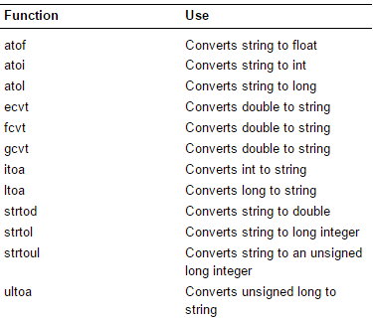
String Data Conversion Functions in C programming

Slide 23
Example for String Data Conversion
itoa () function in C language converts int data type to string data type. Syntax for this function is given below.
char * itoa ( int value, char * str, int base );
“stdlib.h” header file supports all the type casting functions in C language. But, it is a non standard function.

Slide 24
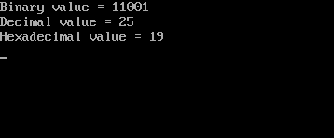
#include <stdio.h>
#include <stdlib.h>
#include <string.h>
void main()
{
int a=25;
char buffer[20];
clrscr();
itoa(a,buffer,2); // here 2 means binary
printf("Binary value = %s\n", buffer);
itoa(a,buffer,10); // here 10 means decimal
printf("Decimal value = %s\n", buffer);
itoa(a,buffer,16); // here 16 means Hexadecimal
printf("Hexadecimal value = %s\n", buffer);
getch();
}
Output

Slide 25
Functions
Functions in C:
Here, you will be introduced to functions (both user-defined and standard library functions) in C programming. Also, you will learn why functions are used in programming.
A function is a block of code that performs a specific task.
Dividing a complex problem into smaller chunks makes our program easy to understand and reuse.

Slide 26
Types of function
There are two types of function in C programming:
Standard library functions
User-defined functions

Slide 27
Why we need functions in C: Functions are used because of following reasons –
C functions are used to avoid rewriting same logic/code again and again in a program.
There is no limit in calling C functions to make use of same functionality wherever required.
We can call functions any number of times in a program and from any place in a program.
A large C program can easily be tracked when it is divided into functions.
The core concept of C functions are, re-usability, dividing a big task into small pieces to achieve the functionality and to improve understandability of very large C programs.

Slide 28
Function declaration, function call and function definition:
There are 3 aspects in each C function. They are:
Function declaration or prototype – This informs compiler about the function name, function parameters and return value’s data type.
Function call – This calls the actual function
Function definition – This contains all the statements to be executed.

Slide 29
Function Definition:
Defining of function is nothing but give body of function that means write logic inside function body.
General syntax for function Definition is,
return type function Name(type1 parameter1, type2 parameter2,...) function header {
local variable declaration; body of the function
function statements ;
a return statement ;
}
Example:
int add(int a, int b) //Function Definition
{
int c;
c=a+b;
return (c);
}

Slide 30
Calling a function:
When we call any function control goes to function body and execute entire code. For call any function just write name of function and if any parameter is required then pass parameter.
General syntax for function call is,
function_name();
or
variable=function_name(argument or list of parameters);
Note: At the time of function calling function must be terminated with Semicolon i.e ‘ ; '.

Slide 31
Example
void main()
{
int x,y,sum;
printf("\n Enter the x and y values:");
scanf("%d%d",&x,&y);
sum= add(x,y); /*Function calling or calling a function
prints("\n Sum of the two numbers: %d“,sum);
getch();
}

Slide 32
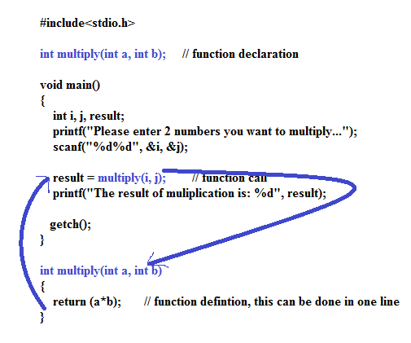
Example of Function
Calling a function

Slide 33
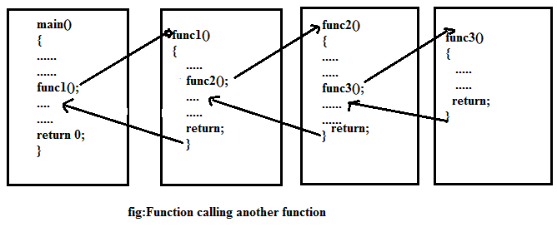

Slide 34
Standard library functions
The standard library functions are built-in functions in C programming.
These functions are defined in header files.
For example,
The printf() is a standard library function to send formatted output to the screen (display output on the screen). This function is defined in the stdio.h header file.
Hence, to use the printf()function, we need to include the stdio.h header file using #include <stdio.h>.
The sqrt() function calculates the square root of a number. The function is defined in the math.h header file.

Slide 35
Predefined standard library functions – such as puts(), gets(), printf(), scanf() etc – These are the functions which already have a definition in header files (.h files like stdio.h), so we just call them whenever there is a need to use them
User Defined functions – The functions that we create in a program are known as user defined functions.(You can also create functions as per your needs. Such functions created by the user are known as user-defined functions.)

Slide 36
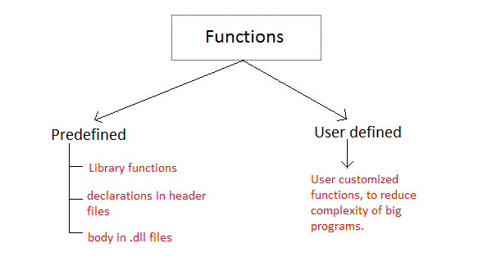
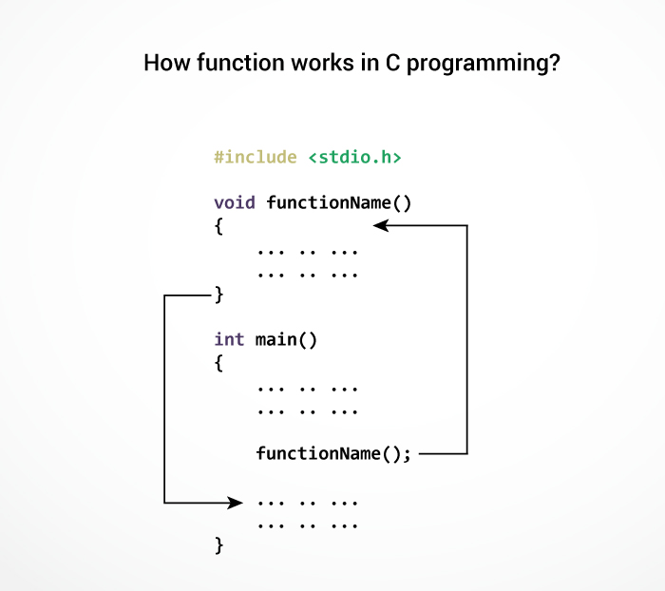

Slide 37
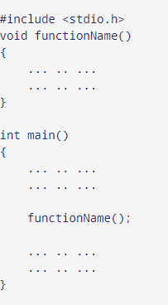
User-defined function
You can also create functions as per your need. Such functions created by the user are known as user-defined functions.
How user-defined function works?
The execution of a C program begins
from the main() function.
When the compiler encounters
functionName();,
control of the program jumps to
void functionName()

Slide 38
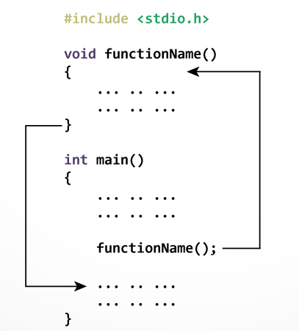

Slide 39
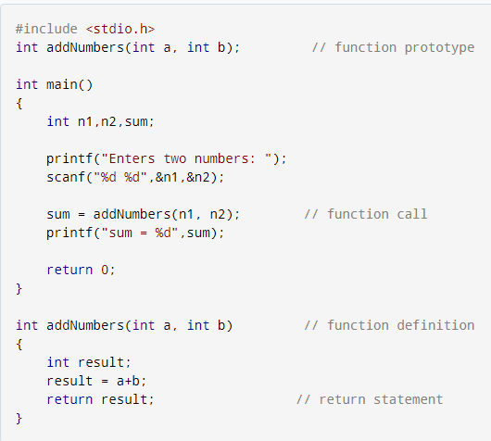
Example: User-defined function
Here is an example to add two integers. To perform this task, we have created an user-defined addNumbers().

Slide 40
C Program to find the square of a number using functions
#include<stdio.h>
// function prototype, also called function declaration
float square ( float x );
// main function, program starts from here
void main( )
{
float m, n ;
printf ( "\nEnter some number for finding square \n");
scanf ( "%f", &m ) ;
// function call
n = square ( m ) ;
printf ( "\nSquare of the given number %f is %f",m,n );
}
float square ( float x ) // function definition
{
float p ;
p = x * x ;
return ( p ) ;
}

Slide 41
Inter Function Communication
When a function gets executed in the program, the execution control is transferred from calling a function to called function and executes function definition, and finally comes back to the calling function.
In this process, both calling and called functions have to communicate with each other to exchange information.
The process of exchanging information between calling and called functions is called inter-function communication.

Slide 42
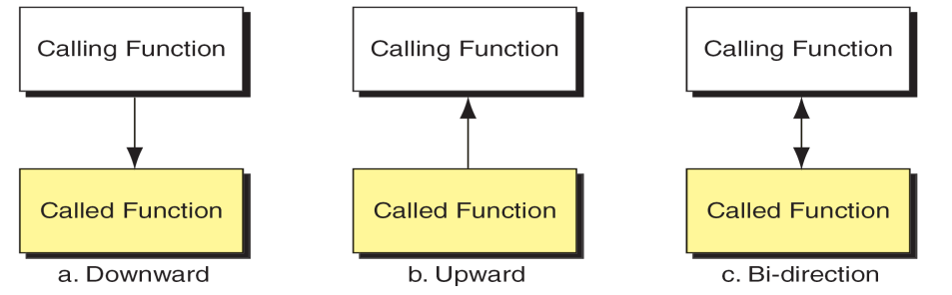
Different methods for transferring data between calling and called function. The data flow between the calling and called functions can be divided into three strategies: (i) Downward Flow (ii) Upward Flow (iii) Bi-directional Flow.

Slide 43
Downward Flow
In this type of inter function communication, the data is transferred from calling function to called function but not from called function to calling function.
The functions with parameters and without return value are considered under downward communication.
In the case of downward communication, the execution control jumps from calling function to called function along with parameters and executes the function definition, and finally comes back to the calling function without any return value.
For example consider the following program...

Slide 44
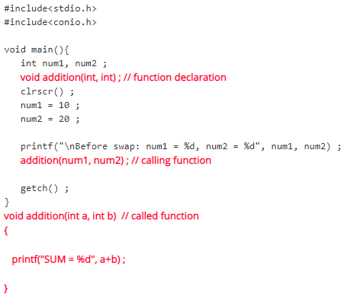
Example for Downward flow

Slide 45
Upward Flow
In this type of inter-function communication, the data is transferred from called function to calling-function but not from calling-function to called-function.
The functions without parameters and with return value are considered under upward communication.
In the case of upward communication, the execution control jumps from calling-function to called-function without parameters and executes the function definition, and finally comes back to the calling function along with a return value.
For example, consider the following program...

Slide 46
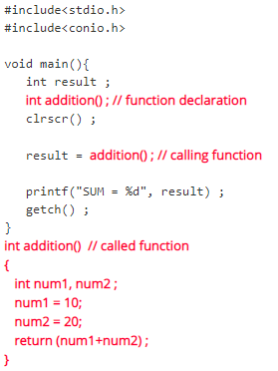
Example for Upward Flow

Slide 47
Bi – Directional Flow
In this type of inter-function communication, the data is transferred from calling-function to called function and also from called function to calling-function.
The functions with parameters and with return value are considered under bi-directional communication.
In the case of bi-directional communication, the execution control jumps from calling-function to called function along with parameters and executes the function definition and finally comes back to the calling function along with a return value.
For example, consider the following program...

Slide 48
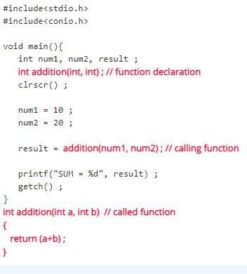
Example for Bi – Directional Flow

Slide 49
The Parameter Passing Mechanisms in C-Language
Most programming languages have 2 strategies to
pass parameters. They are
(i) pass by value
(ii) pass by reference

Slide 50
(i) Pass by value (or) call by value :-
In this method calling function sends a copy of actual values to called function, but the changes in called function does not reflect the original values of calling function.
#include <stdio.h> int sum (int n); void main() { int a = 5; printf("\n The value of 'a' before the calling function is = %d", a); a = sum(a); printf("\n The value of 'a' after calling the function is = %d", a); } int sum (int n) { n = n + 20; printf("\n Value of 'n' in the called function is = %d", n); return n; }
Output: The value of 'a' before the calling function is = 5 Value of 'n' in the called function is = 25 The value of 'a' after calling the function is = 25

Slide 51
Pass by reference (or) call by address
In Call by Reference parameter passing method, the memory location address of the actual parameters is copied to formal parameters. This address is used to access the memory locations of the actual parameters in called function. In this method of parameter passing, the formal parameters must be pointer variables.
That means in call by reference parameter passing method, the address of the actual parameters is passed to the called function and is received by the formal parameters (pointers). Whenever we use these formal parameters in called function, they directly access the memory locations of actual parameters. So the changes made on the formal parameters effects the values of actual parameters. For example consider the following program...

Slide 52
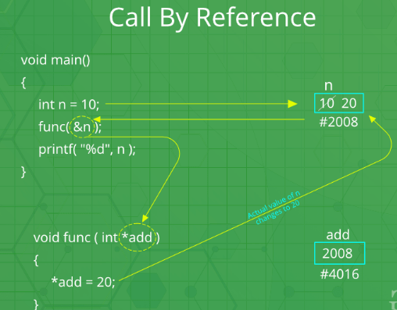

Slide 53
(ii) Pass by reference (or) call by address :-
#include <stdio.h>
int sum (int *n);
void main()
{
int a = 5;
clrscr();
printf("\n The value of 'a' before the calling function is = %d", a);
sum(&a);
printf("\n The value of 'a' after calling the function is = %d", a);
getch();
}
int sum (int *n)
{
*n = *n + 20;
printf("\n value of 'n' in the called function is = %d", n);
return(0);
}
Output: The value of 'a' before the calling function is = 5 value of 'n' in the called function is = -1079041764 The value of 'a' after calling the function is = 25

Slide 54
Various categories of user defined functions in C
A function depending on whether arguments are present or not and whether a value is returned or not may belong to any one of the following categories:
(i ) Functions with no arguments and no return values.
(ii) Functions with arguments and no return values.
(iii) Functions with arguments and return values.
(iv) Functions with no arguments and return values.

Slide 55
(i ) Functions with no arguments and no return values.
Function with no argument means the called function does not receive any data from calling function and Function with no return value means calling function does not receive any data from the called function. So there is no data transfer between calling and called function.
/* program to calculate the area of square */
#include <stdio.h>
void area(); //function prototype
int main()
{
area(); //function call
return 0;
}
void area()
{
int square_area,square_side;
printf("Enter the side of square :");
scanf("%d",&square_side);
square_area = square_side * square_side;
printf("Area of Square = %d",square_area);
}

Slide 56
(ii) Functions with arguments and no return values.
When a function has arguments data is transferred from calling function to called function. The called function receives data from calling function and does not send back any values to calling function. Because it doesn’t have return value.
#include<stdio.h>
void add(int,int);
int main()
{
int a, b;
printf(“enter value”);
scanf(“%d%d”,&a,&b);
add(a,b);
return 0;
}
void add (int x, int y)
{
int z ;
z=x+y;
printf ("The sum =%d",z);
}

Slide 57
(iii) Functions with arguments and return values
In this data is transferred between calling and called function. That means called function receives data from calling function and called function also sends the return value to the calling function.
Example
#include<stdio.h>
#include <conio.h> int add( int, int);
void main()
{
int a,b,c; printf(“enter value”);
scanf(“%d%d”,&a,&b);
c=add(a,b);
printf ("The sum =%d",c);
}
int add (int x, int y)
{
int z;
z=x+y;
return z;
}
output : enter values 2 3
The sum = 5

Slide 58
(iv) Functions with no arguments and return values
When function has no arguments data can not be transferred to called function. But the called function can send some return value to the calling function.
Example
#include<stdio.h>
#include <conio.h>
int add( );
void main()
{
int c;
c=add();
printf ("The sum =%d",c);
}
int add ()
{
int x,y,z;
printf(“enter value”);
scanf(“%d%d”,&a,&b);
z=x+y;
return z;
}
Output: enter values 2 3
The sum = 5

Slide 59
Differentiate Actual parameters and Formal parameters: Formal and actual parameters must match exactly in type, order, and number. Formal and actual parameters need not match for their names.
Actual parameters
The list of variables in calling function isknown as actual parameters.
Actual parameters are variables that are declared in function call.
Actual parameters are passed without using type
main( )
{
……….
function_name (actual parameters);
……..
}
Formal parameters
The list of variables in called function is known as formal parameters.
Formal parameters are variables that are declared in the header of the function definition.
Formal parameters have type preceding with them.
return_typefunction_name(formal parameters)
{
…..
function body;
………..
}

Slide 60
Scope of a function
The variable scope defines the visibility of variable in the program. Scope of a variable depends on the position of variable declaration.
In C programming language, a variable can be declared in three different positions and they are as follows...
Before the function definition (Global Declaration)
Inside the function or block (Local Declaration)
In the function definition parameters (Formal Parameters)

Slide 61
Before the function definition (Global Declaration)
Global variables are defined outside a function, usually on top of the program. Global variables hold their values throughout the lifetime of your program and they can be accessed inside any of the functions defined for the program.
A global variable can be accessed by any function. That is, a global variable is available for use throughout your entire program after its declaration. The following program show how global variables are used in a program.

Slide 62
Example for Global Declaration
#include <stdio.h>
/* global variable declaration */
int g;
void main () {
/* local variable declaration */
int a, b;
/* actual initialization */
a = 10;
b = 20;
g = a + b;
printf ("value of a = %d, b = %d and g = %d\n", a, b, g);
getch();
}

Slide 63
Local Variables
Variables that are declared inside a function or block are called local variables. They can be used only by statements that are inside that function or block of code.
Local variables are not known to functions outside their own. The following example shows how local variables are used. Here all the variables a, b, and c are local to main() function.

Slide 64
Example for Local Variables
#include <stdio.h>
void main ()
{
/* local variable declaration */
int a, b;
int c;
/* initialization */
a = 10;
b = 20;
c = a + b;
printf ("value of a = %d, b = %d and c = %d\n", a, b, c);
getch();
}

Slide 65
Formal Parameters
Formal parameters, are treated as local variables with-in a function and they take precedence over global variables. Following is an example −

Slide 66
Formal Parameters
#include <stdio.h>
/* global variable declaration */
int a = 20;
void main ()
{
/* local variable declaration in main function */
int a = 10;
int b = 20;
int c = 0;
printf ("value of a in main() = %d\n", a);
c = sum( a, b);
printf ("value of c in main() = %d\n", c);
getch();
}
/* function to add two integers */
int sum(int a, int b)
{
printf ("value of a in sum() = %d\n", a);
printf ("value of b in sum() = %d\n", b);
return a + b;
}

Slide 67
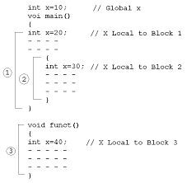

Slide 68
Pointers: Introduction
Pointers in C are easy and fun to learn. Some C programming tasks are performed more easily with pointers, and other tasks, such as dynamic memory allocation, cannot be performed without using pointers.
As we know, every variable is a memory location and every memory location has its address defined which can be accessed using ampersand (&) operator, which denotes an address in memory.

Slide 69
Initialize a pointer
After declaring a pointer, we initialize it like standard variables with a variable address.
To get the address of a variable, we use the ampersand (&)operator, placed before the name of a variable whose address we need.
Pointer initialization is done with the following syntax.
pointer = &variable;

Slide 70

Example: Consider the following example, which prints the address of the variables defined
#include <stdio.h>
void main ()
{
int var1;
char var2[10];
printf(“\nAddress of var1 variable: %x", &var1 );
printf(“\nAddress of var2 variable: %x", &var2 );
getch();
}
Output

Slide 71
What are Pointers?
A pointer is a variable whose value is the address of another variable, i.e., direct address of the memory location.
Like any variable or constant, you must declare a pointer before using it to store any variable address.
The general form of a pointer variable declaration is
datatype *var-name;
datatype is the pointer's base type; it must be a valid C data type and
var-name is the name of the pointer variable.
The asterisk * used to declare a pointer

Slide 72
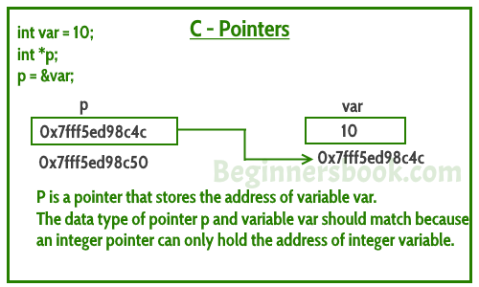

Slide 73
Take a look at some of the valid pointer declarations −
int *ip; /* pointer to an integer */
double *dp; /* pointer to a double */
float *fp; /* pointer to a float */
char *ch /* pointer to a character */

Slide 74

How to Use Pointers?
#include <stdio.h>
void main ()
{
int var = 20; /* actual variable declaration */
int *ip; /* pointer variable declaration */
ip = &var; /* store address of var in pointer variable*/
printf(“\nAddress of var variable: %x", &var);
/* address stored in pointer variable */
printf("\nAddress stored in ip variable: %x", ip);
/* access the value using the pointer */
printf("\nValue of *ip variable: %d", *ip);
getch();
}
Output

Slide 75

NULL Pointers
It is always a good practice to assign a NULL value to a pointer variable in case you do not have an exact address to be assigned.
This is done at the time of variable declaration. A pointer that is assigned NULL is called a null pointer.
Example:
#include <stdio.h>
int main ()
{
int *ptr = NULL;
printf(“\nThe value of ptr is : %x", ptr );
return 0;
}
Output

Slide 76
In most of the operating systems, programs are not permitted to access memory at address 0 because that memory is reserved by the operating system.
However, the memory address 0 has special significance; it signals that the pointer is not intended to point to an accessible memory location. But by convention, if a pointer contains the null (zero) value, it is assumed to point to nothing.
To check for a null pointer, you can use an 'if' statement as follows −
if(ptr) /* succeeds if p is not null */
if(!ptr) /* succeeds if p is null */

Slide 77
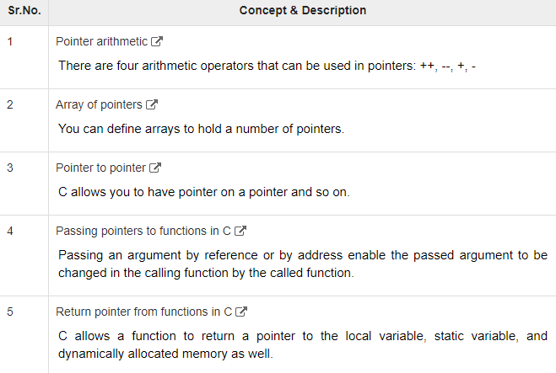

Slide 78
Pointer Expressions and Pointer Arithmetic
A limited set of arithmetic operations can be performed on pointers. A pointer may be:
incremented ( ++ )
decremented ( — )
an integer may be added to a pointer ( + or += )
an integer may be subtracted from a pointer ( – or -= )
Pointer arithmetic is meaningless unless performed on an array.
Note : Pointers contain addresses. Adding two addresses makes no sense, because there is no idea what it would point to.

Slide 79
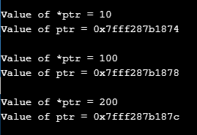
C program to illustrate Pointer Arithmetic
#include <stdio.h>
int main()
{
// Declare an array
int v[3] = {10, 100, 200};
// Declare pointer variable
int *ptr;
// Assign the address of v[0] to ptr
ptr = v;
for (int i = 0; i < 3; i++)
{
printf("\nValue of *ptr = %d", *ptr);
printf("\nValue of ptr = %p", ptr);
// Increment pointer ptr by 1
ptr++;
}
}
Output

Slide 80
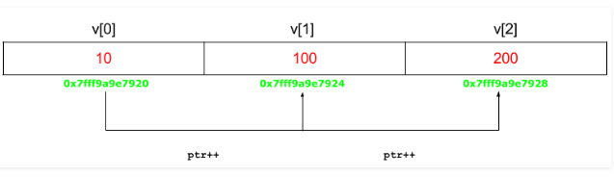

Slide 81
Pointers For Inter Function Communications
In the c programming language, there are two ways to pass parameters to functions. They are as follows...
Call by Value
Call By Reference
We use pointer variables as formal parameters in call by reference parameter passing method.
In case of call by reference parameter passing method, the address of actual parameters is passed as arguments from the calling function to the called function. To receive this address, we use pointer variables as formal parameters.

Slide 82

Example - Swapping of two variable values using Call by Reference
#include<stdio.h>
#include<conio.h>
void swap(int *, int *) ;
void main()
{
int a = 10, b = 20 ;
clrscr() ;
printf(“Before swap : a = %d and b = %d\n", a, b) ;
swap(&a, &b) ;
printf(“After swap : a = %d and b = %d\n", a, b) ;
getch() ;
}
void swap(int *x, int *y)
{
int temp ;
temp = *x ;
*x = *y ;
*y = temp ;
}
Output

Slide 83

Pointers to Pointers
A pointer to a pointer is a form of multiple indirection, or a chain of pointers. Normally, a pointer contains the address of a variable. When we define a pointer to a pointer, the first pointer contains the address of the second pointer, which points to the location that contains the actual value as shown below.
A variable that is a pointer to a pointer must be declared as such. This is done by placing an additional asterisk in front of its name.
For example, the following declaration declares a pointer to a pointer of type int −
int **var;

Slide 84

Example
#include <stdio.h>
void main ()
{
int var;
int *ptr;
int **pptr;
var = 3000;
/* take the address of var */
ptr = &var;
/* take the address of ptr using address of operator & */
pptr = &ptr;
/* take the value using pptr */
printf("\nValue of var = %d", var );
printf("\nValue available at *ptr = %d", *ptr );
printf("\nValue available at **pptr = %d", **pptr);
getch();
}
Output

Slide 85
Compatibility of Pointers in C
The rules for assigning one pointer to another are tighter than the rules for numeric types. For example, you can assign an int value to a double variable without using a type conversion, but you can’t do the same for pointers to these two types.
Let’s see a simple C program to exemplify this.

Slide 86
Example
/* ptr_compatibility.c -- program illustrates concept of pointer * compatibility */
#include <stdio.h>
int main(void)
{
int n = 5;
long double x;
int *pi = &n;
long double *pld = &x;
x = n; /* implicit type conversion */
pld = pi; /* compile-time error: assigning pointer-to-int to */
/* pointer-to-long-double */
return 0;
}

Slide 87
Lvalue and Rvlaue
lvalue or Location Value is anything whose address is accessible. It means we can take address of lvalue using & operator.
Example 1:
int x = 1;
In above expression, x is an lvalue because we can access the address of x
i.e.
int * ptr = &x;

Slide 88
Example 2:
int z = x + 1;
In above expression, we can take address of z
i.e. int * ptr2 = &z;
Therefore, z is lvalue. But we cannot take the address of x+1 i.e.
int * ptr3 = &(x+1); // Compile Error
Above line will not compile because we are trying to address of (x+1) and (x+1) doesn’t persist after single expression. As, we cannot take the address of (x+1). So, (x+1) is not an lvalue.

Slide 89
Rvalue is anything that is not lvalue. It means we cannot take address of rvalue and it also don’t persist beyond the single expression.
Example 1:
int x = 1;
Here you can not take the address of 1 i.e.
int * ptr = &(1); // Compile Error
Therefore, 1 is not a lvalue and hence it 1 is rvalue.

Slide 90
Examples
int a = 7; // a is lvalue & 7 is rvalue
int b = (a + 2); // b is lvalue & (a+2) is rvalue
int c = (a + b) ; // c is lvalue & (a+b) is rvalue
int * ptr = &a; // Possible to take address of lvalue

Slide 91
Pointer Applications

Slide 92
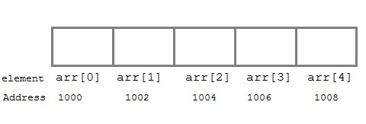
Arrays and Pointers
When an array is declared, compiler allocates sufficient amount of memory to contain all the elements of the array. Base address i.e address of the first element of the array is also allocated by the compiler.
Suppose we declare an array arr,
int arr[5] = { 1, 2, 3, 4, 5 };
Assuming that the base address of arr is 1000 and each integer requires two bytes, the five elements will be stored as follows:

Slide 93
Here variable arr will give the base address, which is a constant pointer pointing to the first element of the array, arr[0].
Hence arr contains the address of arr[0] i.e 1000.
In short, arr has two purpose - it is the name of the array and it acts as a pointer pointing towards the first element in the array.
arr is equal to &arr[0] by default
We can also declare a pointer of type int to point to the array arr.
int *p;
p = arr;
// or,
p = &arr[0]; //both the statements are equivalent.
Now we can access every element of the array arr using p++ to move from one element to another.

Slide 94
Pointer to Array
we can use a pointer to point to an array, and then we can use that pointer to access the array elements.
#include <stdio.h>
void main()
{
int i;
int a[5] = {1, 2, 3, 4, 5};
int *p = a; // same as int*p = &a[0]
for (i = 0; i < 5; i++)
{
printf("%d", *p);
p++;
}
getch();
}
In the above program, the pointer *p will print all the values stored in the array one by one. We can also use the Base address (a in above case) to act as a pointer and print all the values.

Slide 95
Pointer to Multidimensional Array
A multidimensional array is of form, a[i][j]. Lets see how we can make a pointer point to such an array. As we know now, name of the array gives its base address.
In a[i][j], a will give the base address of this array, even a + 0 + 0 will also give the base address, that is the address of a[0][0] element.
Here is the generalized form for using pointer with multidimensional arrays.
*(*(a + i) + j)
also same as
a[i][j]

Slide 96
Pointer and Character strings
Pointer can also be used to create strings. Pointer variables of char type are treated as string.
char *str = "Hello";
The above code creates a string and stores its address in the pointer variable str. The pointer str now points to the first character of the string "Hello".
char *str;
str = "hello"; //this is Legal
The content of the string can be printed using printf() and puts().
printf("%s", str);
puts(str);

Slide 97
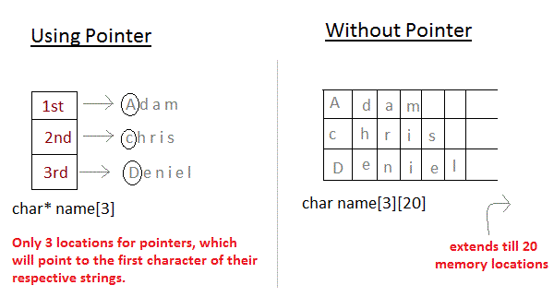
Array of Pointers
We can also have array of pointers. Pointers are very helpful in handling character array with rows of varying length.
char *name[3] = { “Adam”, “chris”, “Deniel” };
//Now lets see same array without using pointer
char name[3][20] = { “Adam”, “chris”, “Deniel” };
In the second approach memory wastage is more, hence it is preferred to use pointer in such cases.

Slide 98
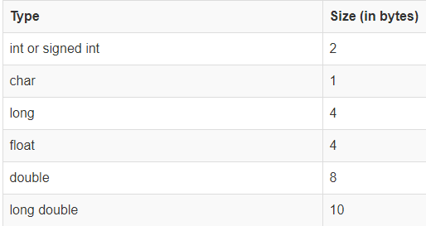
Pointer Arithmetic and Arrays
If you want to have complete knowledge of pointers, pointer arithmetic is very important to understand.
In a 16 bit machine(Turbo C), size of all types of pointer, be it int*, float*, char* or double* is always 2 bytes.
Size of datatypes on 16-bit Machine:

Slide 99
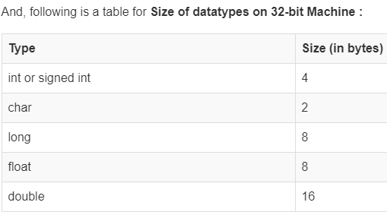
32 bit Machine

Slide 100
Program for pointer arithmetic(32-bit machine)
#include <stdio.h>
void main()
{
int m = 5, n = 10, a = 0;
int *p1;
int *p2;
int *p3;
p1 = &m; //printing the address of m
p2 = &n; //printing the address of n
printf("p1 = %d\n", p1);
printf("p2 = %d\n", p2);
a = *p1+*p2;
printf("*p1+*p2 = %d\n", a);//point 1
p3 = p1-p2;
printf("p1 - p2 = %d\n", p3); //point 2
p1++;
printf("p1++ = %d\n", p1); //point 3
p2--;
printf("p2-- = %d\n", p2); //point 4
//Below line will give ERROR
printf("p1+p2 = %d\n", p1+p2); //point 5
getch();
}

Slide 101
Following arithmetic operations are possible on the pointer in C language:
Increment
Decrement
Addition
Subtraction
Comparison

Slide 102
Let's see the example of incrementing pointer variable
#include<stdio.h>
void main()
{
int number=50;
int *p; //pointer to int
p=&number; //stores the address of number variable
printf("Address of p variable is %u \n",p);
p=p+1;
printf("After increment: Address of p variable is %u \n",p); // in our case, p will get incremented by 4 bytes.
getch();
}

Slide 103
Memory Allocations Functions
An array is a collection of a fixed number of values. Once the size of an array is declared, you cannot change it.
Sometimes the size of the array you declared may be insufficient. To solve this issue, you can allocate memory manually during run-time. This is known as dynamic memory allocation in C programming.
To allocate memory dynamically, library functions are malloc(), calloc(), realloc() and free() are used. These functions are defined in the <stdlib.h> header file.

Slide 104
C malloc()
The name "malloc" stands for memory allocation.
The malloc() function is used to dynamically allocate a single large block of memory with the specified size. And, it returns a pointer of void which can be casted into pointers of any form.
Syntax of malloc()
ptr = (castType*) malloc(size);
Example:
ptr = (float*) malloc(100 * sizeof(float));
The above statement allocates 400 bytes of memory. It's because the size of float is 4 bytes. And, the pointer ptr holds the address of the first byte in the allocated memory.

Slide 105
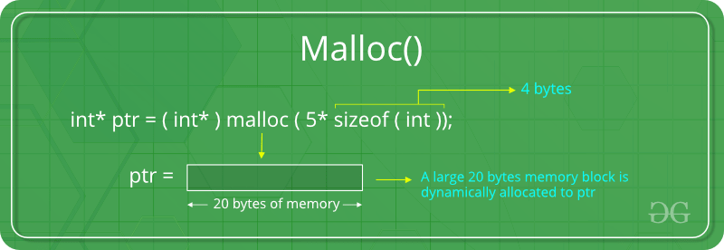

Slide 106
C calloc()
The name "calloc" stands for contiguous allocation.
“calloc” or “contiguous allocation” method in C is used to dynamically allocate the specified number of blocks of memory of the specified type. It initializes each block with a default value ‘0’.
Syntax of calloc()
ptr = (castType*)calloc(n, size);
Example:
ptr = (float*) calloc(25, sizeof(float));
The above statement allocates contiguous space in memory for 25 elements of type float.

Slide 107
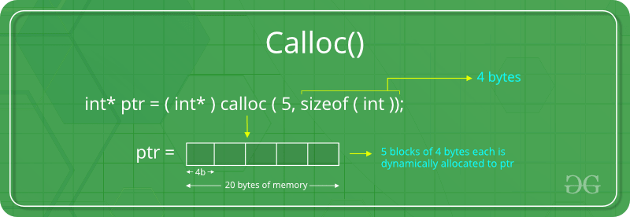

Slide 108
C free()
Dynamically allocated memory created with either calloc() or malloc() doesn't get freed on their own. You must explicitly use free() to release the space.
Syntax of free()
free(ptr);
This statement frees the space allocated in the memory pointed by ptr.

Slide 109
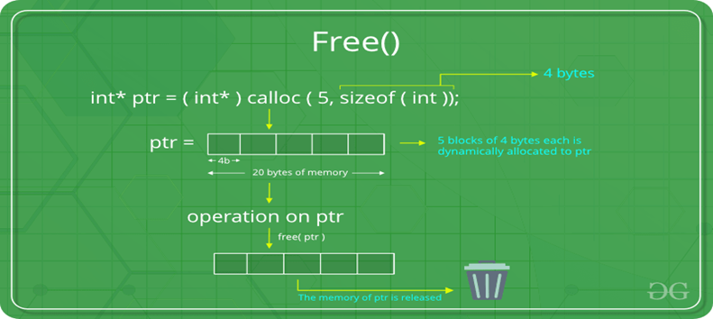

Slide 110
C realloc()
If the dynamically allocated memory is insufficient or more than required, you can change the size of previously allocated memory using the realloc() function.
Syntax of realloc()
ptr = realloc(ptr, x);
Here, ptr is reallocated with a new size x.

Slide 111
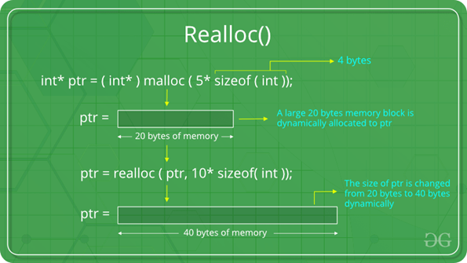

Slide 112
Text Input/output: Files
Why files are needed?
When a program is terminated, the entire data is lost. Storing in a file will preserve your data even if the program terminates.
If you have to enter a large number of data, it will take a lot of time to enter them all.
However, if you have a file containing all the data, you can easily access the contents of the file using a few commands in C.
You can easily move your data from one computer to another without any changes.

Slide 113
Types of Files
When dealing with files, there are two types of files
Text files
Binary files
Text files
Text files are the normal .txt files. We can easily create text files using any simple text editors such as Notepad.
When you open those files, you'll see all the contents within the file as plain text. You can easily edit or delete the contents.
They take minimum effort to maintain, are easily readable, and provide the least security and takes bigger storage space.

Slide 114
Binary files
Binary files are mostly the .bin files in your computer.
Instead of storing data in plain text, they store it in the binary form (0's and 1's).
They can hold a higher amount of data, are not readable easily, and provides better security than text files.

Slide 115
File Operations
In C, you can perform four major operations on files, either text or binary:
Creating a new file
Opening an existing file
Closing a file
Reading from and writing information to a file
Working with files
When working with files, you need to declare a pointer of type file. This declaration is needed for communication between the file and the program.
FILE *fptr;

Slide 116
Opening a file - for creation and edit
Opening a file is performed using the fopen() function defined in the stdio.h header file.
The syntax for opening a file in standard I/O is:
fptr = fopen("fileopen","mode");
For example,
fopen("E:\\cprogram\\newprogram.txt","w");
fopen("E:\\cprogram\\oldprogram.bin","rb");

Slide 117
Let's suppose the file newprogram.txt doesn't exist in the location E:\cprogram. The first function creates a new file named newprogram.txt and opens it for writing as per the mode 'w'.
The writing mode allows you to create and edit (overwrite) the contents of the file.
Now let's suppose the second binary file oldprogram.bin exists in the location E:\cprogram. The second function opens the existing file for reading in binary mode 'rb'.
The reading mode only allows you to read the file, you cannot write into the file

Slide 118
Opening Modes in Standard I/O
Mode | Meaning of Mode | During Inexistence of file
r | Open for reading. | If the file does not exist, fopen() returns NULL.
rb | Open for reading in binary mode. | If the file does not exist, fopen() returns NULL.
w | Open for writing. | If the file exists, its contents are overwritten. If the file does not exist, it will be created.
wb | Open for writing in binary mode. | If the file exists, its contents are overwritten. If the file does not exist, it will be created.
a | Open for append. Data is added to the end of the file. | If the file does not exist, it will be created.
ab | Open for append in binary mode. Data is added to the end of the file. | If the file does not exist, it will be created.
r+ | Open for both reading and writing. | If the file does not exist, fopen() returns NULL.
rb+ | Open for both reading and writing in binary mode. | If the file does not exist, fopen() returns NULL.
w+ | Open for both reading and writing. | If the file exists, its contents are overwritten. If the file does not exist, it will be created.
wb+ | Open for both reading and writing in binary mode. | If the file exists, its contents are overwritten. If the file does not exist, it will be created.
a+ | Open for both reading and appending. | If the file does not exist, it will be created.
ab+ | Open for both reading and appending in binary mode. | If the file does not exist, it will be created.

Slide 119
Closing a File
The file (both text and binary) should be closed after reading/writing.
Closing a file is performed using the fclose() function.
fclose(fptr);
Here, fptr is a file pointer associated with the file to be closed.

Slide 120
Reading and writing to a text file
For reading and writing to a text file, we use the functions fprintf() and fscanf().
They are just the file versions of printf() and scanf(). The only difference is that fprint() and fscanf() expects a pointer to the structure FILE.

Slide 121
Example : Write to a text file
#include <stdio.h>
#include <stdlib.h>
void main()
{
int num;
FILE *fptr;
fptr = fopen("C:\\program.txt","w");
if(fptr == NULL)
{
printf("Error!");
exit(1);
}
printf("Enter num: ");
scanf("%d",&num);
fprintf(fptr,"%d",num);
fclose(fptr);
getch();
}

Slide 122
The above example program takes a number from the user and stores in the file program.txt.
After you compile and run this program, you can see a text file program.txt created in C drive of your computer. When you open the file, you can see the integer you entered.

Slide 123
Example : Read from a text file
#include <stdio.h>
#include <stdlib.h>
void main()
{
int num;
FILE *fptr;
if ((fptr = fopen("C:\\program.txt","r")) == NULL)
{
printf("Error! opening file");
// Program exits if the file pointer returns NULL.
exit(1);
}
fscanf(fptr,"%d", &num);
printf("Value of n=%d", num);
fclose(fptr);
getch();
}

Slide 124
The above example program reads the integer present in the program.txt file and prints it onto the screen.
If you successfully created the file from Example 1, running this program will get you the integer you entered.
Other functions like fgetchar(), fputc() etc. can be used in a similar way.

Slide 125
Streams
In C all input and output is done with streams
Stream is nothing but the sequence of bytes of data
A sequence of bytes flowing into program is called input stream
A sequence of bytes flowing out of the program is called output stream
Use of Stream make I/O machine independent.
Predefined Streams :
stdin | Standard Input
stdout | Standard Output
stderr | Standard Error

Slide 126
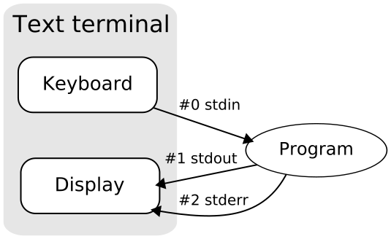

Slide 127
Standard Input Stream Device :
stdin stands for (Standard Input)
Keyboard is standard input device .
Standard input is data (Often Text) going into a program.
The program requests data transfers by use of the read operation.
Not all programs require input.

Slide 128
Standard Output Stream Device :
stdout stands for (Standard Output)
Screen(Monitor) is standard output device .
Standard output is data (Often Text) going out from a program.
The program sends data to output device by using write operation.

Slide 129
Difference Between Std. Input and Output Stream Devices :
Point | Std i/p Stream Device | Standard o/p Stream Device
Stands For | Standard Input | Standard Output
Example | Keyboard | Screen/Monitor
Data Flow | Data (Often Text) going into a program | data (Often Text) going out from a program
Operation | Read Operation | Write Operation

Slide 130
Standard Library Input/Output Functions
Input means to provide the program with some data to be used in the program and Output means to display data on screen or write the data to a printer or a file.
C programming language provides many built-in functions to read any given input and to display data on screen when there is a need to output the result.

Slide 131
scanf() and printf() functions
The standard input-output header file, named stdio.h contains the definition of the functions printf() and scanf(), which are used to display output on screen and to take input from user respectively.
#include<stdio.h>
void main()
{
int i;
printf("Please enter a value...");
scanf("%d", &i);
printf( "\nYou entered: %d", i);
}

Slide 132
getchar() & putchar() functions
The getchar() function reads a character from the terminal and returns it as an integer.
This function reads only single character at a time. You can use this method in a loop in case you want to read more than one character. The putchar() function displays the character passed to it on the screen and returns the same character.
This function too displays only a single character at a time. In case you want to display more than one characters, use putchar() method in a loop.

Slide 133
#include <stdio.h>
void main( )
{
int c;
printf("Enter a character");
/*
Take a character as input and
store it in variable c
*/
c = getchar();
/*
display the character stored
in variable c
*/
putchar(c);
}

Slide 134
gets() & puts() functions
The gets() function reads a line from stdin(standard input) into the buffer pointed to by str pointer, until either a terminating newline or EOF (end of file) occurs. The puts() function writes the string str and a trailing newline to stdout.
str → This is the pointer to an array of chars where the C string is stored.

Slide 135
#include<stdio.h>
void main()
{
/* character array of length 100 */
char str[100];
printf("Enter a string");
gets( str );
puts( str );
getch();
}

Slide 136
Standard Library Input/Output Functions
C Header Files
<assert.h> | Program assertion functions
<ctype.h> | Character type functions
<locale.h> | Localization functions
<math.h> | Mathematics functions
<setjmp.h> | Jump functions
<signal.h> | Signal handling functions
<stdarg.h> | Variable arguments handling functions
<stdio.h> | Standard Input/Output functions
<stdlib.h> | Standard Utility functions
<string.h> | String handling functions
<time.h> | Date time functions

